Slide 1
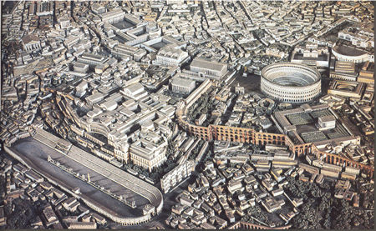
The Roman Empire

Slide 2
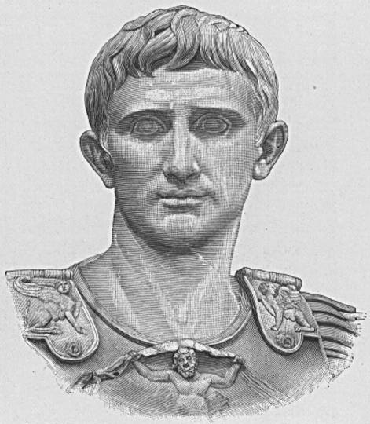
Caesar Augustus
63 BC-14 AD
Octavian was winner of 18 years civil war
Designated heir of Julius Caesar
Was of the family of Caesar (adopted) so he took the name Caesar
Given the name Augustus by the Senate

Slide 3
Caesar Augustus
Beginning the Empire
Marked by the reign of Octavian
Returned to principles of the republic (in theory)
But, created important changes to make it work
Senate received power of nominal governing
Allowed free elections
Accepted title “princeps civitatis” or first citizen ("prince")
Initially offered to retire to private life
Held a variety of jobs but ruled effectively regardless of position
Auctoritas = prestige, power from trust, influence
Who else has had this kind of power?
How does a leader get this kind of power?

Slide 4
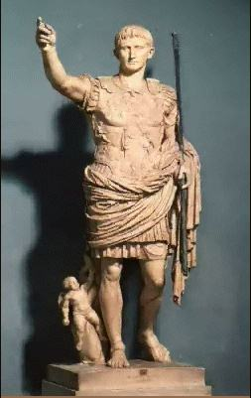
Caesar Augustus
Beginning the Empire
Augustinian Code
Roman Law was rewritten and solidified
Basis of western laws today
Equity
Honest government
Added to the road system
53,000 miles of paved roads
Postal system and other city infrastructure
Standard currency system
Improved harbors

Slide 5
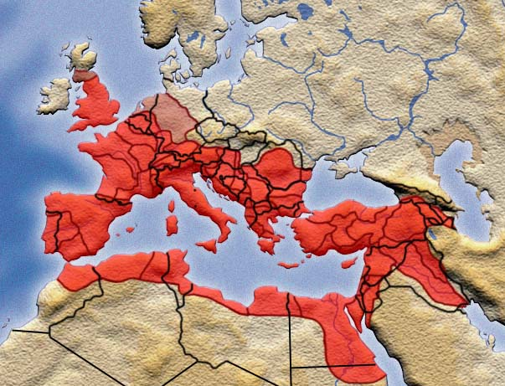
Caesar Augustus
Military
Reduced the size but created a permanent army
Territorial expansion
Purpose: to consolidate boundaries, ensure peace
Generalship given to loyalists—Agrippa and Tiberius
German defeat/consolidation (Herman the German)
Central Europe and the Balkans expansion
Spain consolidation
Africa, annexation of Egypt
Pax Romana
60 million people in peace for more than 400 years

Slide 6
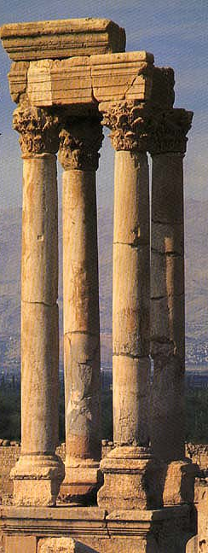
Caesar Augustus
Worship of “Roma et Augustus”
Allowed the east and west unity of worship (each in their own way)
Didn’t push worship so as to not alienate local worship

Slide 7
Caesar Augustus
Succession
No male heir
Adopted nephew, Tiberius
Smooth transition of leadership
Stable leadership despite inept emperors
Tiberius took the title "emperor" and all successors did the same
Succession was a problem for the entire time of the empire

Slide 8
Principal Roman Emperors

Slide 9
Julio-Claudians
Emperors who succeeded Caesar for 50 years
Tiberius
Ruled well if somewhat ineffective
Retired due to opposition
Caligula
Insane
Killed by troops
Claudius
Good administrator
Uncomfortable around people (lame and stuttered)
Nero
Mother killed Claudius for Nero
Nero killed his mother
Seneca and Burrus (advisors, died from Nero pressure)
Revolt and burning of the city
Committed suicide

Slide 10
Seneca
“Avoid shabby attire, long hair, an unkempt beard, an outspoken dislike for comfortable furnishings, and all other misguided and childish means of self-advertisement.”

Slide 11
“It is not the man who has too little who is poor. It is the one who relentlessly hankers after more. What difference does it make how much is laid away in a man’s safe or in his barns, or how much capital he puts out at interest, if he is only after what he doesn’t have and only counts what he has yet to acquire, never what he already has.”
– Seneca

Slide 12
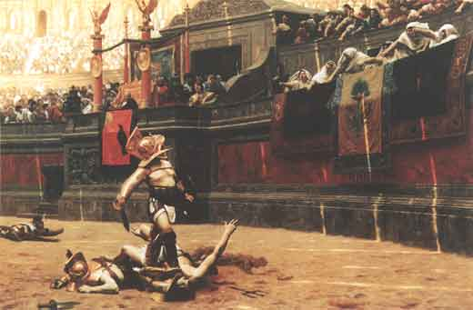
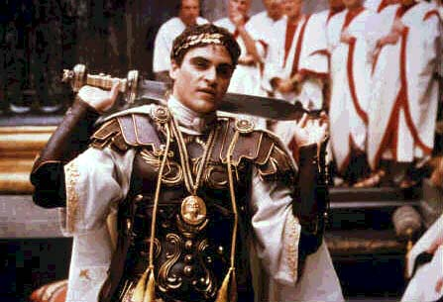
The Golden Age (100-180AD)
Life in the Golden Age
Rome was largest city in the ancient world
Extravagant entertainment
Prosperity through trade and population expansion
After the Golden Age
Good and bad emperors
Unsuited for governance
Many boy emperors
Gladiator

Slide 13
Third Century Disaster
Near collapse of the empire
Military-oriented emperors
Threat from consolidated Germans
24 emperors and 24 claimants/usurpers
45 killed by assassination (usually by their own troops)
1 died in battle
1 died in captivity
1 died of plague
Name of a Caesar reflects self-importance

Slide 14
“Emperor Caesar Galerius Valerius Maximianus Invictus Augustus, Pontifex Maximum, Germanicus Maximus, Egyptiacus Maximus, Thebaicus Maximus, Sarmaticus Maximus five times, Persicus Maximus twice, Carpicus Maximus, Holder of Tribunician Authority for the twentieth time, Imperator for the nineteenth, Consul for the eighth, Pater Patriae, Proconsul.”

Slide 15
Diocletian
284-305 AD
Ruled by decree
Stabilized the empire
Strong general with army support
Imposed will on governmental agencies
Unity
Worship of emperor as a mark of loyalty
Persecution of the Christians
About non-participation and separateness
Not about beliefs

Slide 16
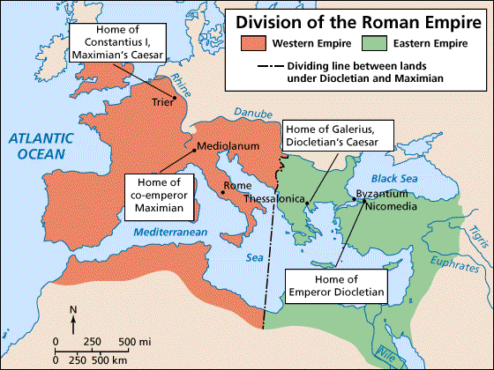
Diocletian
Divided the empire for better administration
Tetrarchy (2 Augusti, 2 Caesars)
Diocletian retired, forced Maximiam to retire
Chaos followed

Slide 17
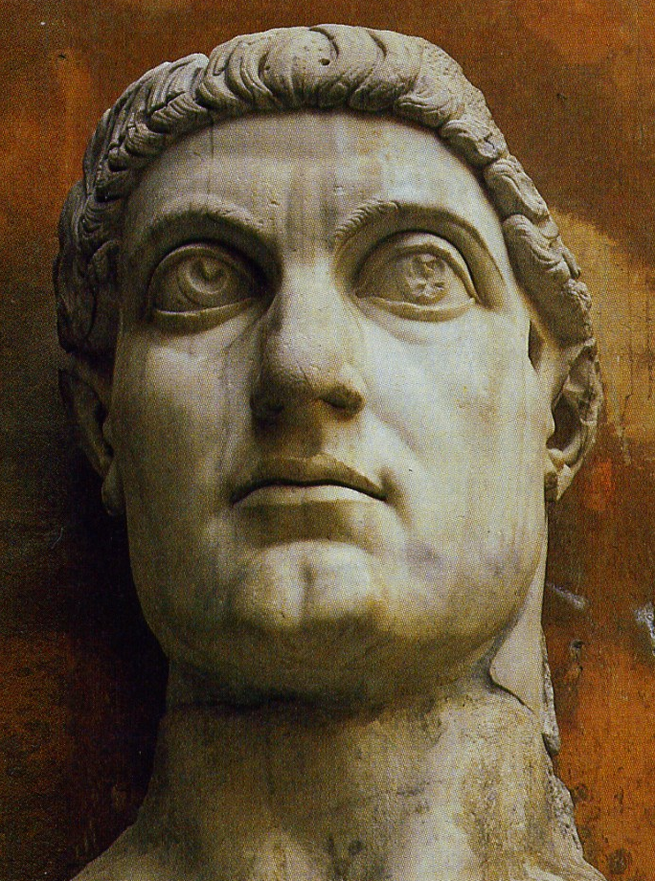
Constantine
306-337 AD
Constantine’s father succeeded Maximian as Augustus
Succeeded his father as Caesar
Became 1 of 7 claimants for control
Fought wars to decide emperor
Vision of a burning Christian symbol (chi-rho)
United the troops and gave them courage that "a god" wanted them to win (most were pagans and accepted the protection of any god)

Slide 18
Constantine
Constantinople
Built on Byzantium site
Acceptance of Christianity
Edict of Milan
Eliminated religious contention
Supported Christian religions
St. Helena, churches
Supported pagan religions
Coins, inscriptions, built temples
Nicaean council (325 AD)
Sought to unify doctrine
Used imperial troops to suppress dissent among Christians (Donatists)
Conversion or unity?

Slide 19
Post-Constantine Period
Theodocius I
Strongest post-Constantine emperor
Instituted Christianity as state religion
Goths joined army to fight against Huns
Revolt in Thessalonica (7000 killed)
This was the first confrontation between the church and the state
Theodocius I forced to beg forgiveness (St. Ambrose)

Slide 20
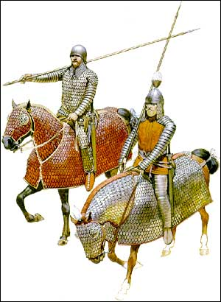
Post-Constantine Period
Ravenna
Rome full of crime, decayed morals
Capital moved to Ravenna
Persians (Parthians)
Attacked eastern providence
Overran the local Roman army
Reinforcement moved to defend the east which weakened the west

Slide 21
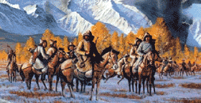
Post-Constantine Period
Huns
Central base in Hungary
Warriors feared by Romans and Germans
Attila—last leader
Invaded Gaul
Defeated in 451 AD by a combined army
Moved into Italy and defeated again
Withdrew to Hungary

Slide 22
Post-Constantine Period
Barbarians (illiterate and non-urban)
Settled in Roman territory after pressure from the Huns
Goths split into two groups
Ostrogoths—eastern Europe
Visigoths—moved to Dacia (Romania)
Allowed to live on Roman land
Barbarians compatible with Romans
Visigoths revolted after unfair taxing
Theodosius the Great bought off the Visigoths

Slide 23
Fall of the Roman Empire
West had longer barbarian frontier
Persians civilized and signed treaties
East had money to pay off invaders
Eastern boundaries easier to defend
Constantinople a fortress city

Slide 24
Barbarian Invasions

Slide 25
The End of Antiquity
The fall of the Roman empire traditionally marks the end of the period of Antiquity
Upcoming time periods
Middle Ages/Renaissance
Byzantine empire
Moslem empire

Slide 26
“A close study of each of these dead civilizations indicates that they usually started on their road to glory because of fortuitous circumstances exploited by a strong, inspiring leader. The nation then carried on for a period under its own momentum. Finally, creeping vanity led the people to become enamored of their undisputed superiority; they became so impressed with their past achievements that they lost interest in working for further change. Soon their sons, coddled in the use of all the great things their fathers and grandfathers had pioneered, became as helpless as new-born babes when faced with the harsh reality of an aggressive and changing world.”
—Eugene K. Von Fange, Professional Creativity

Slide 27
Thank You

Slide 28
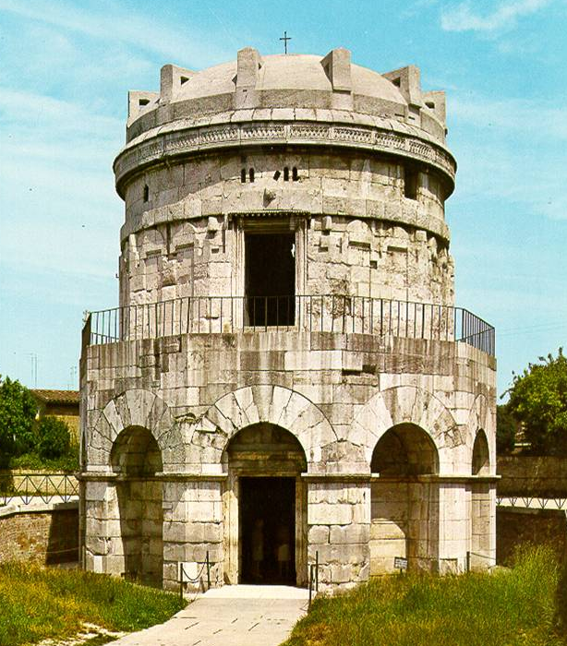
Post-Constantine Period
Theodoric the Great
Chief over the Ostrogoths
Conquered Odoacer and declared himself king of Rome
Bothius
Writer who summarized Euclid, Archimedes, Ptolemy, and Aristotle into Latin
The Ostrogoths’ reign
Ended shortly after Theodoric’s death
The eastern part of the empire lasted 1000 years

Slide 30
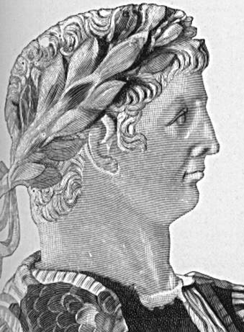
Julio-Claudians
Tiberius (14-37 AD)
Adopted son of Augustus
Designated successor
Reigned well
Retired due to opposition
Sea of Tiberius—Sea of Galilee

Slide 31
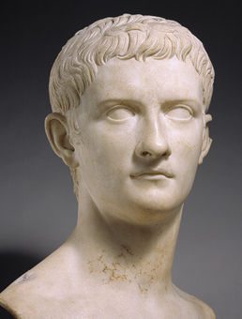
Julio-Claudians
Caligula (37-41 AD)
Descendent of Augustus
Played solider as a boy
Nickname Caligula— “little boot”
Thought to be insane
Claimed to be all the gods at once
Murdered after insulting the army

Slide 32
Julio-Claudians
Claudius (41-54 AD)
Born in Gaul (Lyon)
Lame and stuttered, so as a child avoided people
Married Agrippina, and adopted Nero
May have been murdered by his wife
Excellent administrator
Divided the government into bureaus
Formed professional civil service

Slide 33
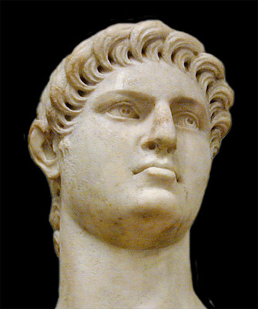
Julio-Claudians
Nero (54-68 AD)
Married Claudius’s daughter
Initially permitted two advisors (Seneca, Burrus)
Assumed total power in 62 AD
Killed mother
Burrus died
Seneca retired
Divorced wife
Burning of Rome
Revolt in 56 AD and Nero killed many conspirators
Peter and Paul killed 54 AD
68 AD Nero committed suicide

Slide 34
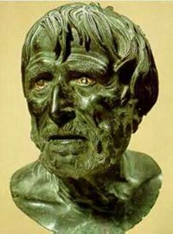
"What does it matter to know what a straight line is if one has no notion of rectitude?"
– Seneca
“Anyone entering our homes should admire us rather than our furnishings.”
– Seneca

Slide 35
“Wild animals run from the dangers they actually see, and once they have escaped them, worry no more. We, however, are tormented alike by what is past and what is to come.”
– Seneca

Slide 36
“A person adopted as a friend solely for the sake of his commercial usefulness will be cultivated only so long as he is thus useful. This explains the crowd of people who cluster about successful men, and the lonely atmosphere about the ruined. To procure friendship only for the better and not for the worse is to rob it of all its dignity.”
– Seneca

Slide 37
Julio-Claudians
Four Claimants (69 AD)
Galba, Otho, Vitellius, Vespasian
All generals
Vespasian defeated the others and became emperor
Vespasian founded the Flavian Dynasty
Turned into monarchy

Slide 38
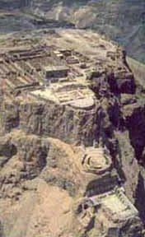
Flavians
69-96 AD
Vespasian, Titus, Domitian
Reasonably good administrators
First non-Patrician Caesar
Suppression of the Jewish revolt
Destruction of Jerusalem
Masada
Timing—70 AD

Slide 39
Age of the Adoptive Emperors
96-193 AD
The Golden Age of Rome
5 good and 1 bad emperor
Nerva, Trajan, Hadrian, Antoninus Pous, Marcus Aurelius, Commodus
None were power hungry except Commodus
Façade of constitutionality
Hadrian separated the civil services from the army
Army changed from greater mobility to maintenance

Slide 40
Spartacus
(Kirk Douglas)
Gladiator
(Russell Crowe)

Slide 41
This powerpoint was kindly donated to www.worldofteaching.com
http://www.worldofteaching.com is home to over a thousand powerpoints submitted by teachers. This is a completely free site and requires no registration. Please visit and I hope it will help in your teaching.

